Slide 1



Analyzing the Federal Reserve's Dual Mandate
This presentation examines the Federal Reserve's efforts to control inflation and unemployment through rate hikes and cuts. We'll analyze the effectiveness of these strategies over the past 25 years using key economic indicators.
by Waheeb Algabri

Slide 2

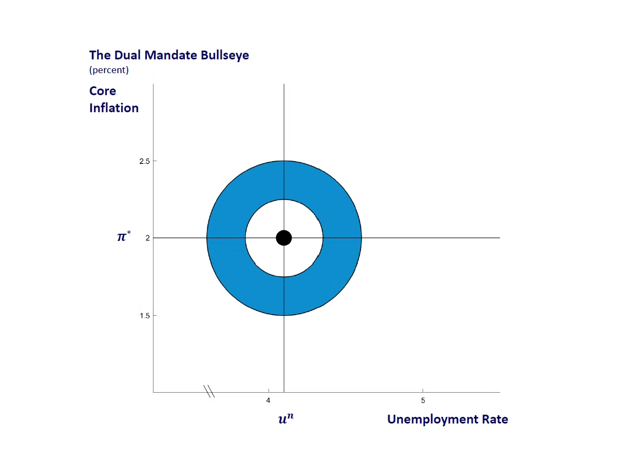
Overview of the Federal Reserve's Mandate
The Federal Reserve aims to manage inflation and unemployment through its dual mandate. We'll analyze the effectiveness of rate hikes and cuts over 25 years.
1
Inflation
Measured by CPI growth
2
Unemployment Rate
Key indicator of economic health
3
Fed Funds Rate
Primary tool for monetary policy

Slide 3
Data Sources and Methods
Data Sources
Analysis Methods
CPI and Unemployment from BLS. Federal Funds Rate from FRED.
Calculating changes during rate cycles. Visualizations created in R using ggplot2.

Slide 4
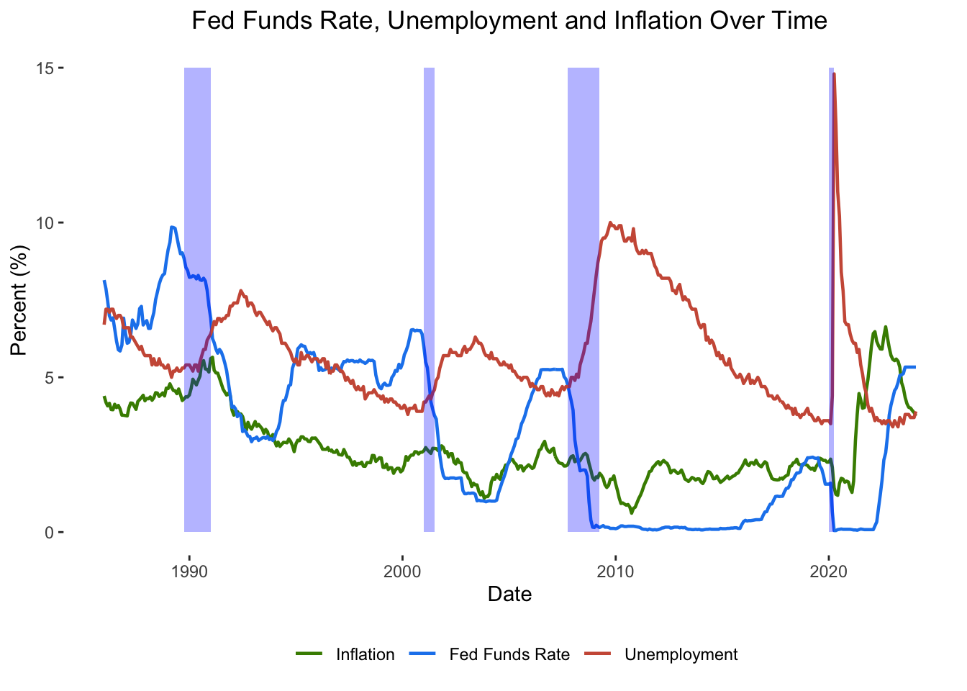
This graph shows trends of Fed Funds Rate (blue), Unemployment Rate (coral), and Inflation (green). Recessions are highlighted in light blue.
Caption

Slide 5

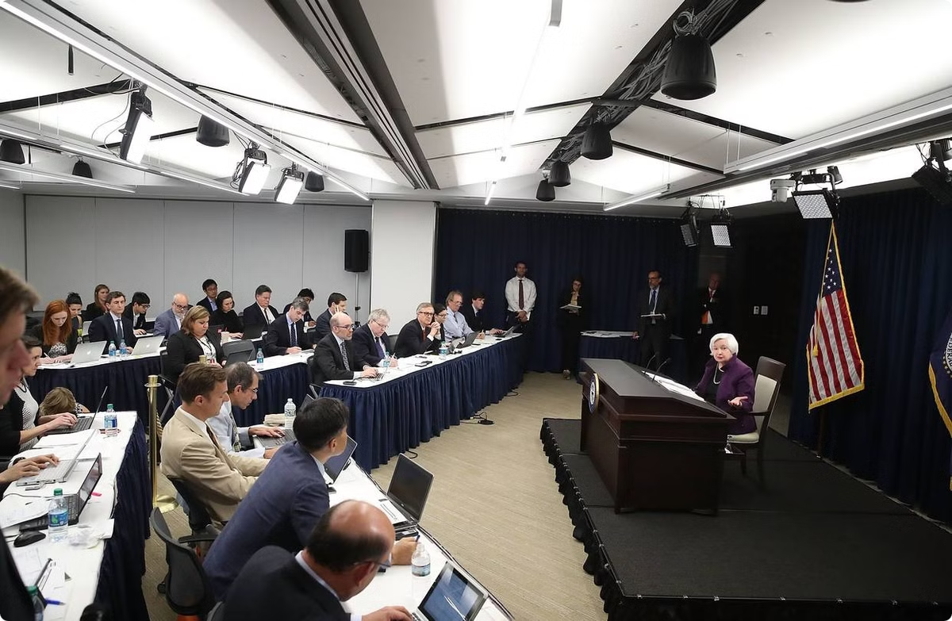
Rate Cut and Hike Cycles
We've identified key periods of Rate Cut Cycles (orange) and Rate Hike Cycles (blue). These represent Fed responses to economic conditions.
1
Rate Cut Cycles
Periods when the Fed lowers interest rates
2
Rate Hike Cycles
Periods when the Fed raises interest rates
3
Economic Conditions
Fed's response to inflation and unemployment

Slide 6
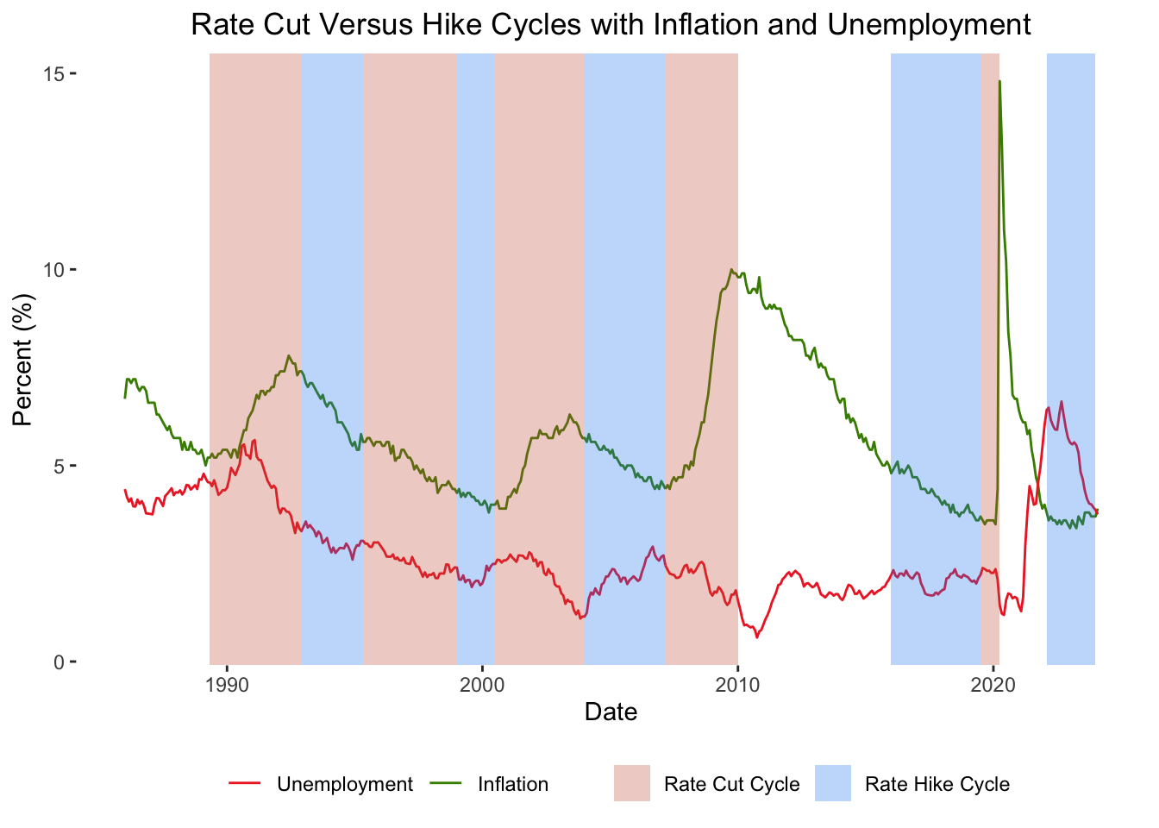



Effects of Rate Cuts on Unemployment and Inflation
Rate Cut
Fed lowers interest rates
Unemployment
Typically decreases
Inflation
May increase
Caption

Slide 7
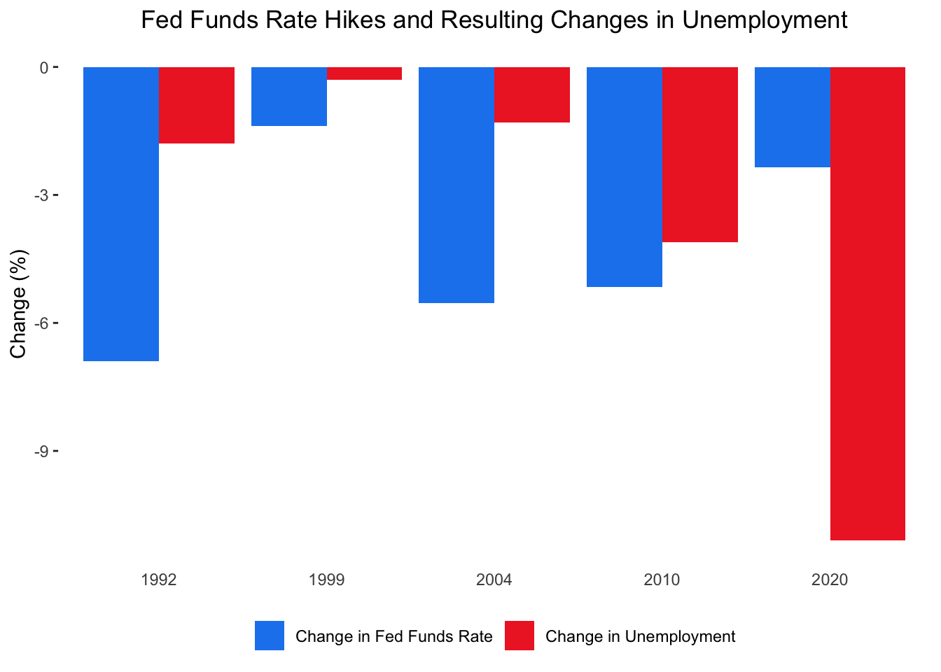
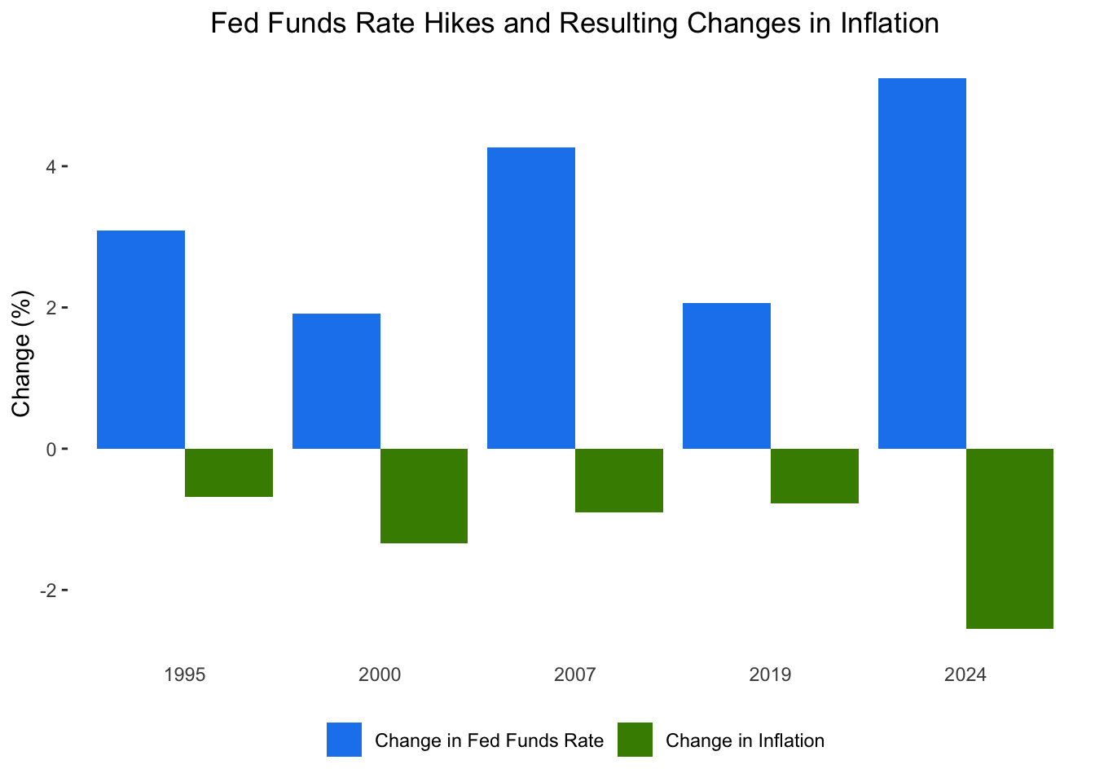
Effects of Rate Hikes on Inflation and Unemployment
Caption
Caption

Slide 8
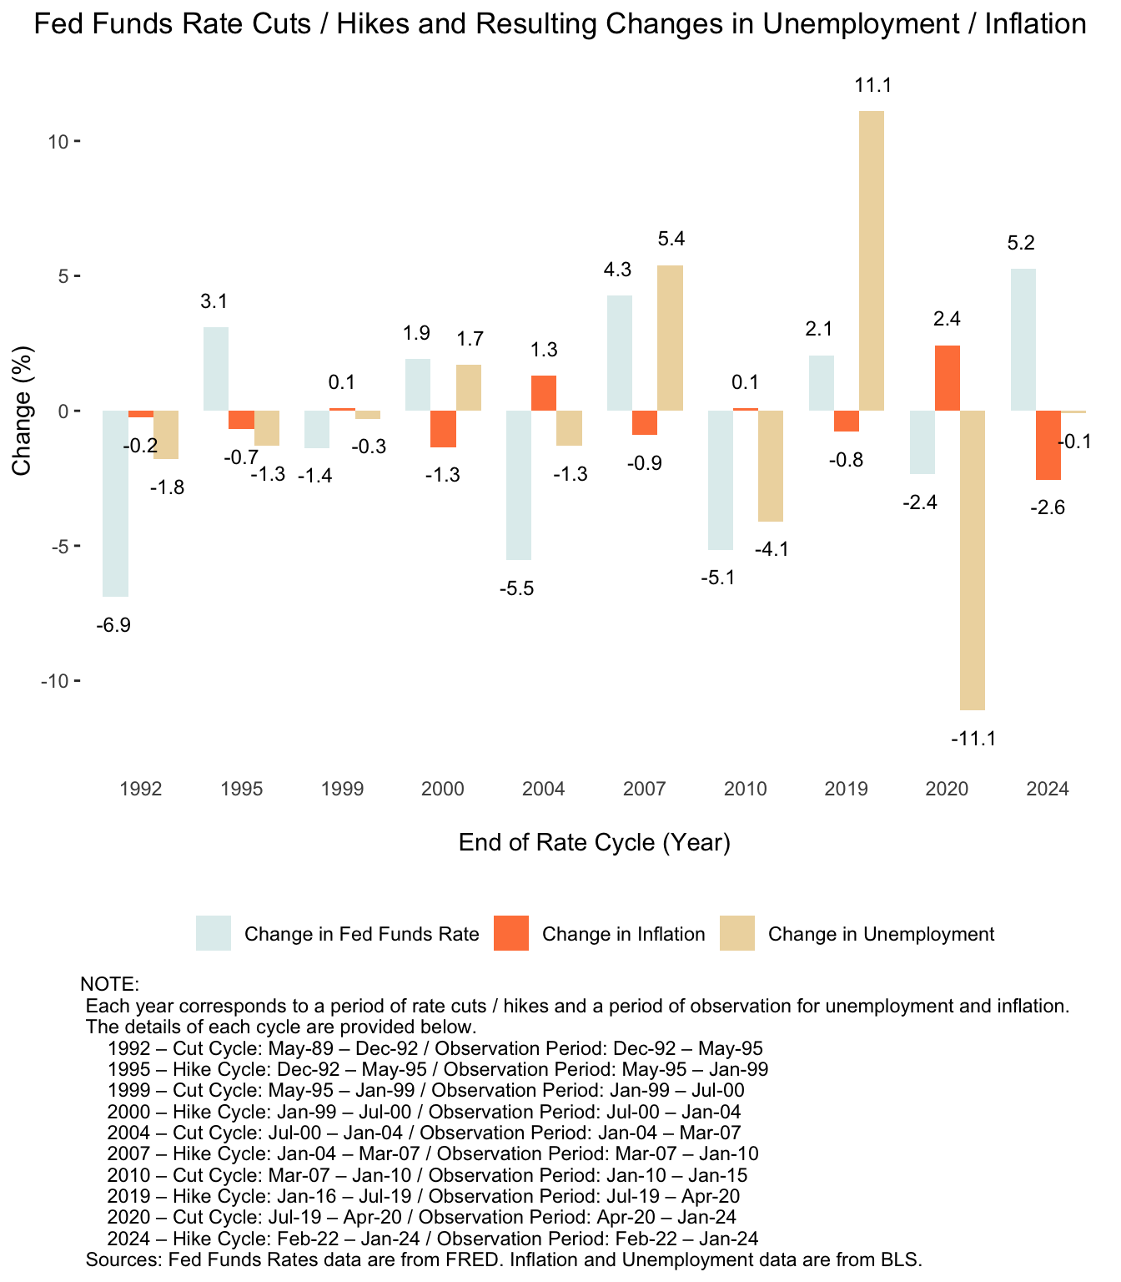
Summary of Results
Reduce unemployment
May increase inflation
Rate Cuts
May increase unemployment
Rate Hikes
Combat inflation
Caption

Slide 9


Concluding Thoughts
Historical Analysis
Reveals challenges in balancing inflation control and job creation
Fed's Success
Generally succeeds, but sometimes one objective comes at the expense of another
Future Decisions
Must carefully weigh trade-offs between managing inflation and promoting employment

Slide 10





Sources and Data
FRED
BLS
R and ggplot2
Source for Fed Funds Rate data
Source for CPI and Unemployment data
Used to create all visualizations

